Slide 1
Software Reverse Engineering of Bomb3D
Presented By:
Pratikshya Mishra (010691200)
Ketki Kulkarni (010699455)

Slide 2
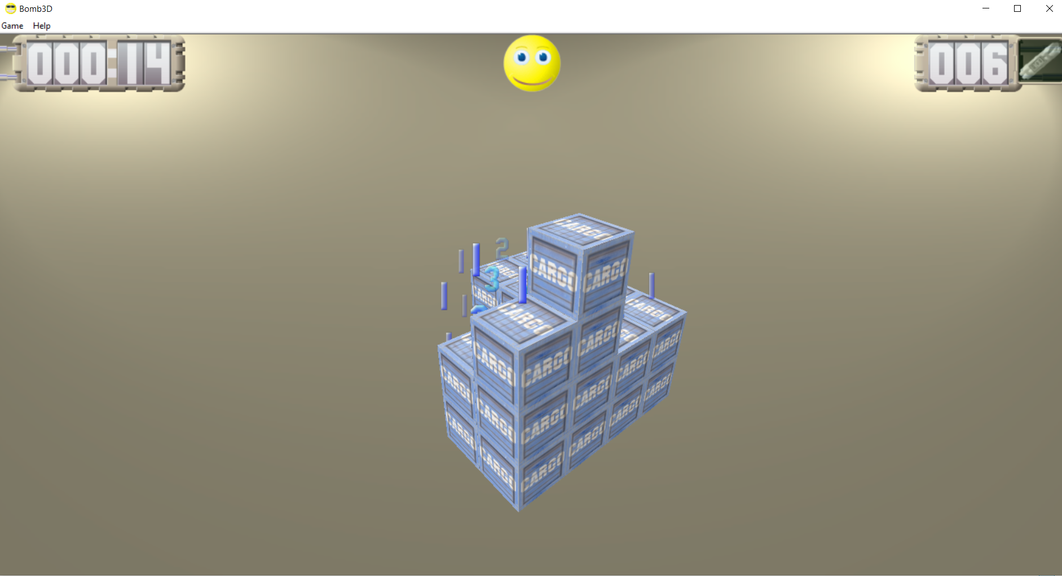
Software Overview
A shareware developed by I2D solutions.
It’s a 3D minesweeper.
It’s a demo version and registered version can be bought for $14.95 from http://www.i2d.com.au/catalog/bomb3d/buy.html

Slide 3

What we did?
Disassembled the program into machine code
Looked into the memory map
Loaded the .rdata onto CPU dump
Checked for the string in dump and find all the functions from where it is referenced
Patched the code
Tools Used
Ollydbg

Slide 4
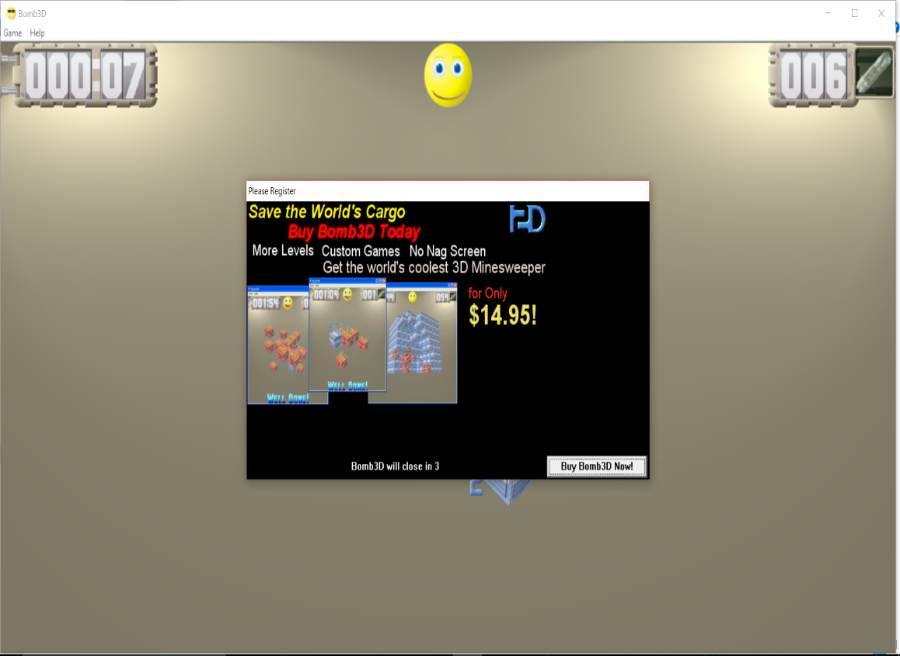
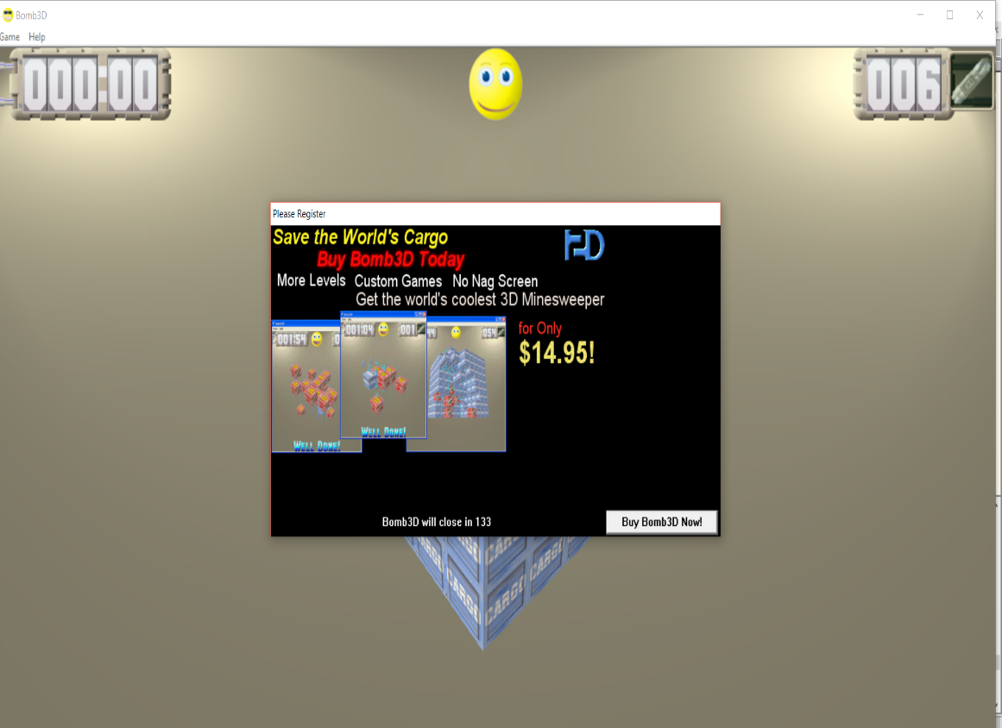
Output
Before
After

Slide 5

Attack Mitigation
Code should be packed
Store hash value of the string messages.
Encrypt the string messages

Slide 6
Demo

Slide 7
Conclusion
The code is obfuscated
Problems Faced
The registration page is not found
The URL for the site was hard coded which gave 404 error
The message box for entering the registration code was not enabled for entering the code.

Slide 8
Bibliography
http://www.tucows.com/preview/330123
http://reversingproject.info/?page_id=42

Slide 9
Any Questions?????????????

Slide 10
Thank you

